Slide 1

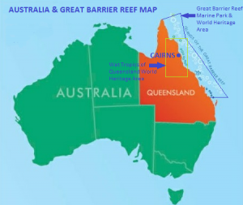

Great Barrier Reef – The Wetlands – Catchment Areas
Click “girl” to explore the 3 areas.
Follow me to explore!
Photo credit: reefexperience.com.au

Slide 2
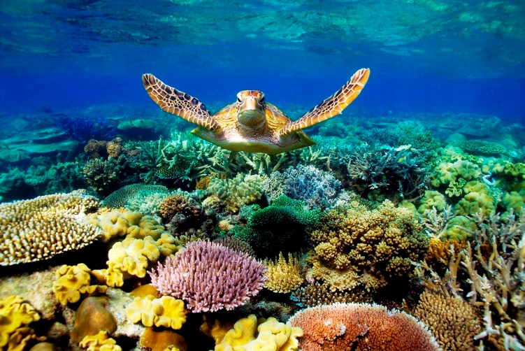
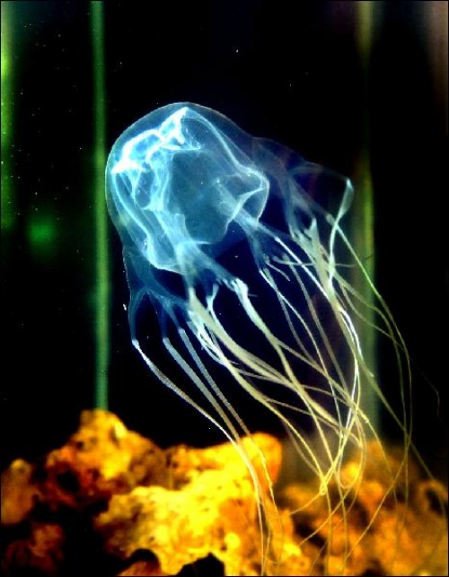
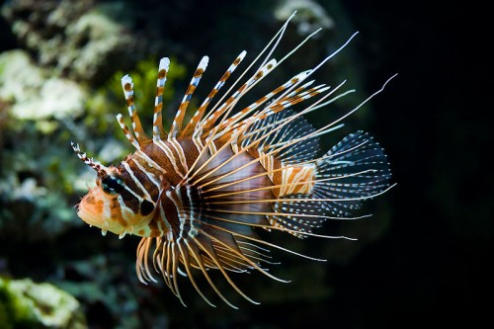
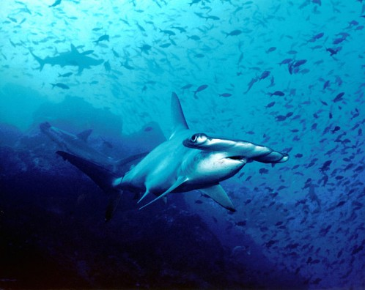
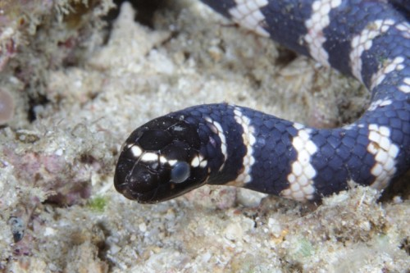
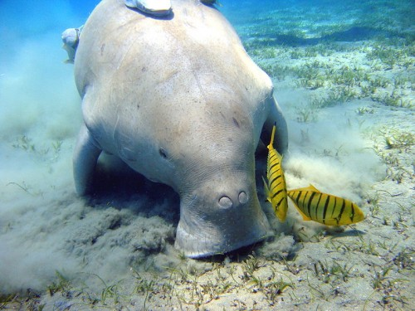
Great Barrier Reef
Click any animal to learn more.
Box Jellyfish
Top 5 Animals
Lionfish
Photo credit: www.sbs.com.au
Hammerhead Shark
Dugong
Turtle-Headed Sea Snake
Photo Credit for other pictures: http://www.animalfacts.ca/top-10-greater-barrier-reef-animals/

